Slide 1

Designing of IoT Solutions
IoT Physical Devices & Endpoints
Charanraj B R
Department of Computer Science Engineering

Slide 2

Designing of Iot solutions
IoT Platforms
Charanraj B R
Department of Computer Science Engineering

Slide 3
Designing of IoT Solution
Outline of Presentation
IoT Platforms

Slide 4
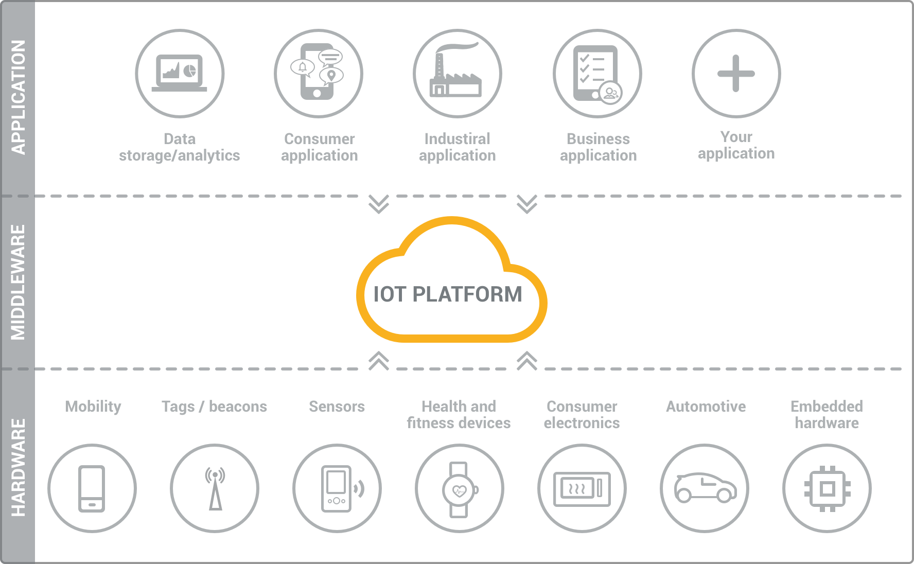
Designing of IoT Solution
IoT Platforms

Slide 5
Designing of IoT Solution
Various IoT Platforms
Amazon Web Services (AWS) IoT platform
Microsoft Azure IoT platform
Google Cloud Platform IoT
IBM Watson IoT platform
Artik Cloud IoT platform

Slide 6

Designing of IoT Solution
Various IoT Platforms
Amazon Web Services (AWS) IoT platform:
Set of services that connect to several devices and maintain the security

Slide 7

Designing of IoT Solution
Various IoT Platforms
2. Microsoft Azure IoT platform:
Strong security mechanism, scalability and easy integration. Bi-directional communication between connected devices and platform.

Slide 8

Designing of IoT Solution
Various IoT Platforms
3. Google Cloud Platform IoT:
Solution for IoT devices and applications. Large amount of data using Cloud IoT.

Slide 9
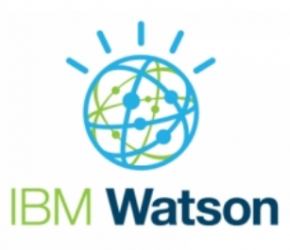
Designing of IoT Solution
Various IoT Platforms
4. IBM Watson IoT platform:
The IBM Watson IoT platform enables the developer to deploy the application and building IoT solutions

Slide 10
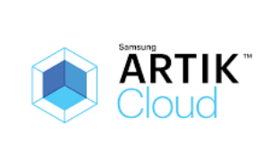
Designing of IoT Solution
Various IoT Platforms
5. Artik Cloud IoT platform:
Set of services that continuously connect devices to the cloud and start gathering data. Data from connected devices and combines.

Slide 11
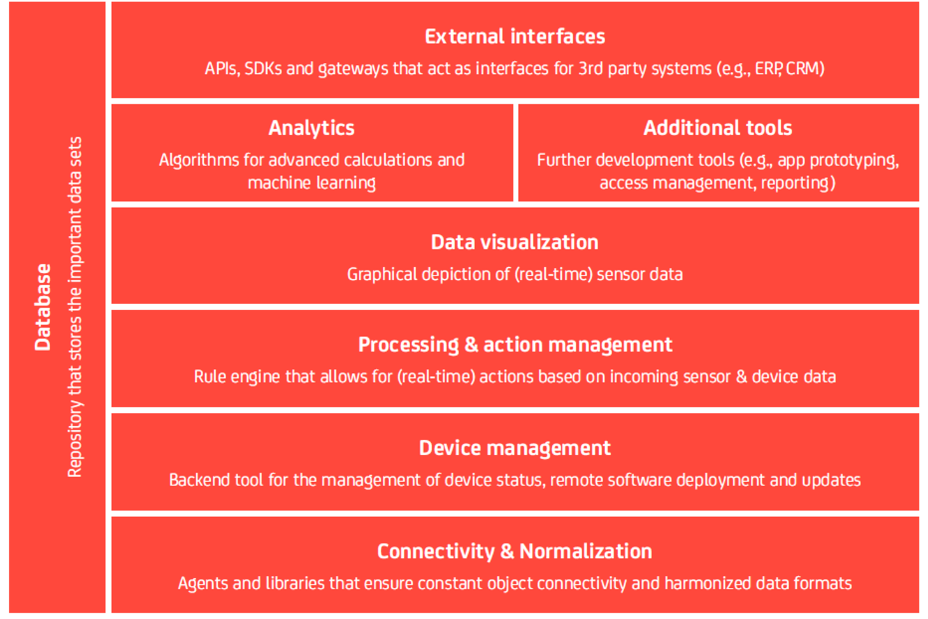
Designing of IoT Solution
Modern IoT Platform architecture

Slide 12
Designing of IoT Solution
Other types of “IoT Platforms”
Connectivity / M2M platforms.
Connectivity of connected IoT devices via telecommunication networks
IaaS backends.
Hosting space and processing power for applications and services.
3. Hardware-specific software platforms.
Own proprietary software backend. Not open to anyone else on the market E.g. Google Nest.
4. Consumer/Enterprise software extensions.
Software packages and OS such as Windows 10 are increasingly allowing the integration of IoT devices.

Slide 13
THANK YOU
Charanraj B R
Department of Computer Science Engineering
charanarajbr@pes.edu
+91 80 6666 3333 Extn 721

